Slide 1
MatcherNet
2018/10/26
Oba&JJ

Slide 2
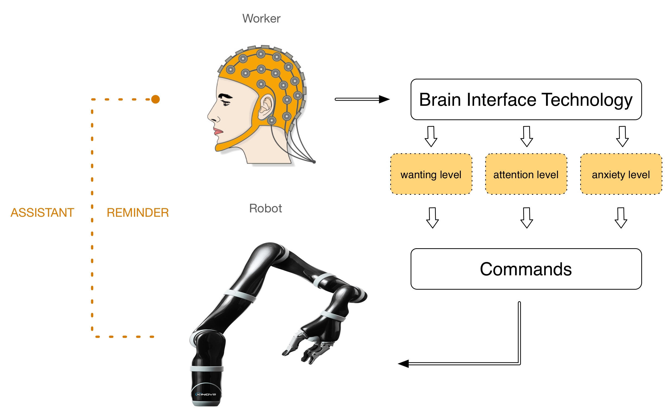
Optimal control
Dynamics model
Obj. fnc.
Optimal motor command or optimal policy
Goal

Slide 3
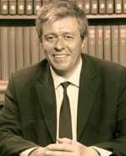
FEP
Free energy principle
How does the brain recognize the external/internal environment and code them? How does the brain determine the behavior 脳は外界の様子をどのように認知し、コーディングし、更新外界に対する行動意思をどのように決定しているか？
Predictive coding theory
FEP
Consider probabilistic recognition state
The recog. state is updated to reduce the free energy with an online manner.
AIF (active inference)
Action a(t) is also determined with FEP
Sensory state recognition state
Surprise
K. Friston
@ UCL

Slide 4

SSM and its linearization
(state space model)
System dynamics model
Observation model
System noise
Observation noise

Slide 5
Multiple sensors

Slide 6
Multiple objects

Slide 7
Factorization
as an assumption/approximation

Slide 8
Hidden variable model

Slide 9
Hidden variable model cntd.
An arbitrary prior ( with useless complexity )
A simpler prior

Slide 10
Inference of hidden “cause”
cause
Probabilistic
Generative
model
state
observation
Inference
process

Slide 11
Inference of hidden “cause”
Nonlinear – multi.obj. – multi.channel ver.
cause
state
observation

Slide 12
Multiple models
observation

Slide 13
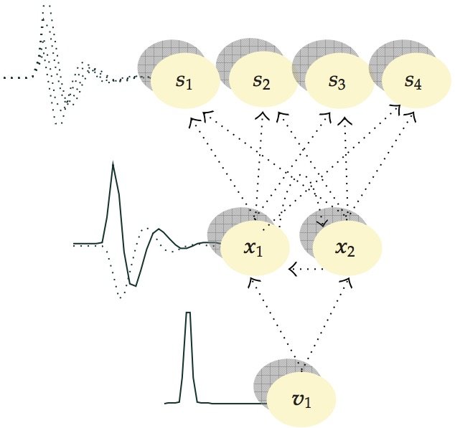
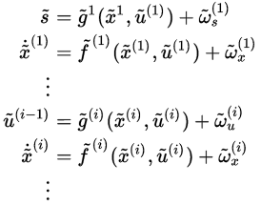
GF (generalized filter) [Friston et al. 2010]
SSM with arbitrary hierarchy
Observation
“State” of the 1st level
“Cause” of the i-1-th level
“State” of the i-th level
Generalized coordinate (continuous time)
almost equivalent to AR model (discrete time)

Slide 14
Probabilistic model of everything

Slide 15
What is the MatcherNet?
MatcherNet is the network of recognition bundles.
The recognition bundle is a bundle of dynamics, state, controller, and its objective.
We connect multiple recognition bundles with matchers that minimizes the error between the bundles.
It is graphically represented as a bipartite graph.
= MatcherNet =
- Bundle
: pedestrian bundle, vectorfield bundle, joint bundle, prediction bundle, observer, predictor
- Matcher
- Observer

Slide 16
Bundles and Matchers
def test_null():
# Making a bundlenet with
# 3 bundles (B0,B1,B2) and 3 matchers (M01, M12, M02).
B0 = BundleNull("B0",4)
B0.state.data["mu"][0][1] = 1
B1 = BundleNull("B1",4)
B1.state.data["mu"][0][2] = 10
B2 = BundleNull("B2",4)
B2.state.data["mu"][0][3] = 100
M01 = MatcherNull2("M01",B0,B1)
M02 = MatcherNull2("M02",B0,B2)
M12 = MatcherNull2("M12",B1,B2)
M = brica1.Module()
M.add_component("B0",B0)
M.add_component("B1",B1)
M.add_component("B2",B2)
M.add_component("M01",M01)
M.add_component("M02",M02)
M.add_component("M12",M12)
s = brica1.VirtualTimeSyncScheduler()
A = brica1.Agent(s)
A.add_submodule("M", M)
#for k in M.components.keys():
# M.components[k].set_results()
# M.components[k].print_state()
A.step()
A.step()
A.step()
A.step()
return A
class Bundle(brica1.Component)
class BundleNull(Bundle)
class Matcher(brica1.Component)
class MatcherNull2(Matcher)
M01
M12
B0
B1
B2

Slide 17
Bundle variants
class Provider(bundlenet.Bundle)
provides serialized data in a sequential manner
at each fire()
class ImageProvider(bundlenet.Bundle) provides sequential image
class Physics(bundlenet.Bundle)
Having physical state, updating it with an explicit/fixed dynamics, and provides it at each fire().

Slide 18
Matcher variants
Class Recorder (bundlenet.Matcher)
records the states of all bundles that links to self
at each fire(). It stores the states in a buffer.

Slide 19
EKF (extended Kalman-filter) overview
Model
Model is defined with a differential eq.
Discretized with time step dt dt will be variable in the other version
Dynamics f(x) Observation g(x) are given and fixed. f() and g() will be variable in the other version
HogeHoge
MatcherEKF
M
B0
B1
Provider
BundleEKFContinuousTime

Slide 20
Discrete Linear and linearized SSM
Linear dynamics model (behind the Kalman filter)
Non-linear dynamics model and its linearization behind the Extended Kalman filter (EKF)

Slide 21
Discrete time EKF
Continuous time EKF

Slide 22
Dividing the EKF algorithm into two modules
Dynamics module (Bundle)
Observation module (Matcher)
Considers Σ

Slide 23
class EKF.BundleEKFContinuousTime
self.apply_feedback( )
self.step_dynamics( )
Call this method for all Matchers
that link to the current Bundle
M0
M1
M2
B1

Slide 24
class EKF.MatcherEKF(bundlenet.Matcher)
self.update()
fetch
M
B0
B1
Provider
BundleMKF
Observation noise
Observation vector

Slide 25
Basic requirement of schedule order
Scheduled
Simulation time
t
t+dt
Computation time
M
calc.
fetch
fetch
B1
calc.
calc.
B0
store

Slide 27
class EKF.MatcherEKF2Way
M
self.update()
fetch
B0
B1

Slide 28
class EKF.MatcherEKF_V2
M
self.update()
fetch
p(x0, x1, …) is an arbitrary
pdf.
B0
B1

Slide 29
Work in progress [2018/08/30]
Architecture
Interface
Applications
BundleNet003
BriCA1
BundleNet005
BriCA parallel
NULL bncmrk
SO
SO+Satia
Satia
EKF
SO
w/o BriCA
SO
BundleNet004
BriCA parallel
Character
JJ
SO+JJ
ITA
Body schema
JJ
BNLUA
w/o BriCA
JJ
JJ
Crowd bncmrk
JJ
PostK 説明会 9/12
PostK 締切 9末
BriCA2 C++

Slide 30
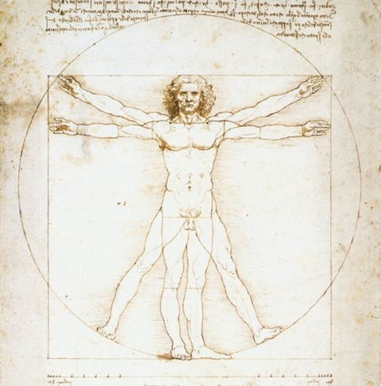
What is “body schema”?
身体図式
A sensory framework for body cognition
in sub-conscious
base of sensory motor integration
modifiable
Note: No rigid definition with consensus
A body image consists of perceptions, attitudes, and beliefs concerning one's body. In contrast, body schema consists of sensory-motor capacities that control movement and posture.

Slide 31
Body schema as Bundlenet
M02
M12
M23
M24
M45
B0
B1
B2
B3
B4
B5
Somatosensory
Signal state
Internal
Recognition
State of body
Abstract
States of body
Intention
State
Visual
Input
Body schema

Slide 32
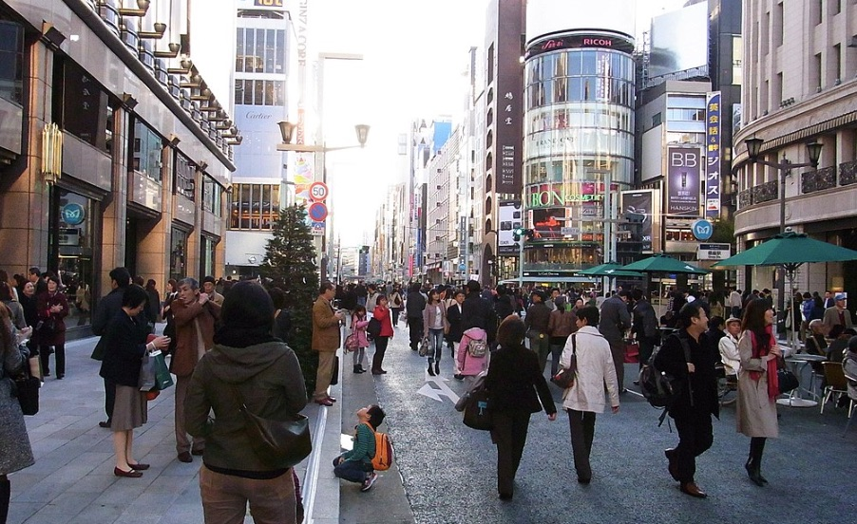
Fallacy-of-composition analyzer 合成の誤謬
Multi-agent system with interaction (MASI) can involve some FC
G2
What is the best path? S1 → G1, S2 → G2
G1
S1
S2
Cooperation/conflict among agents may change the optimal policies.
Multi-agent crowd simulation → schematic solutions

Slide 33
Data assimilation simulation of MASI
How can we estimate the purpose of the crowd?

Slide 34
Potential field / vector field model of MASI
BF
M
BF
M
Trajectory model (past-current-future)
with interaction model among agents.
Field models
Agent models

Slide 35
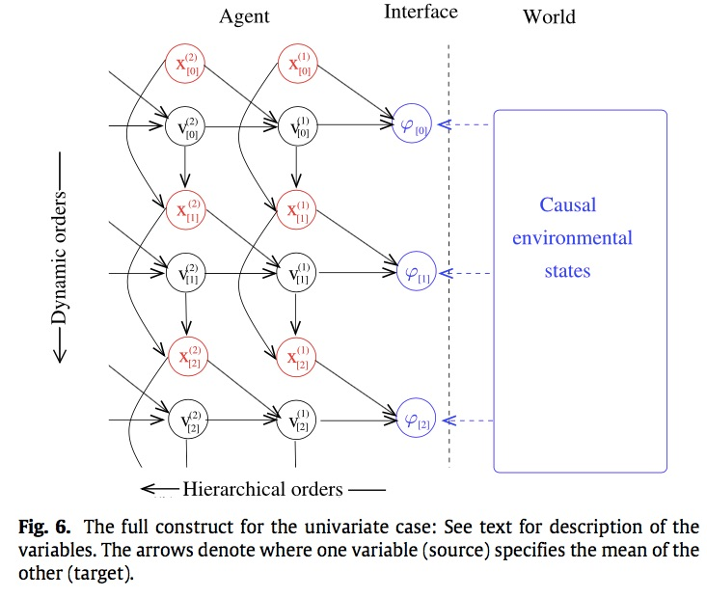

Slide 36
Internal model
External world
Causal
environmental
states
Dynamics time orders
Hierarchical orders

Slide 37
Internal model
External world
Causal
environmental
states
Dynamics time orders
Hierarchical orders

Slide 38
Internal model
External world
Causal
environmental
states
Dynamics time orders
Hierarchical orders

Slide 39
Internal state space model
External world
Environment
Bundlenet structure

Slide 40
Computation time
Observation time

Slide 41
Computation time
Observation time

